Slide 1





Perovskite Performance on
Glass and Metal Substrates
Rayna Hylden
Dr. Nick Rolston, School of Electrical, Computer and Energy Engineering
Arizona State University
Arizona Space Grant Statewide Symposium
19 April 2025

Slide 2
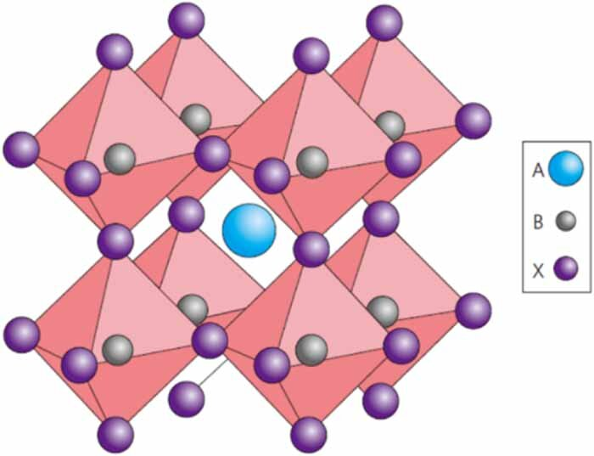
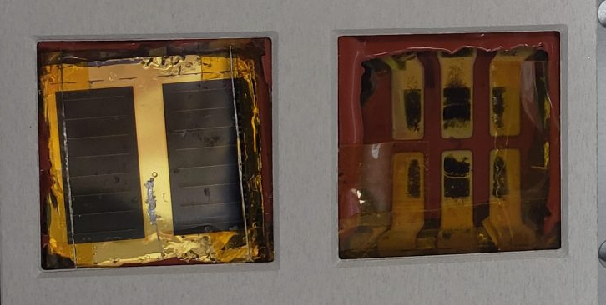
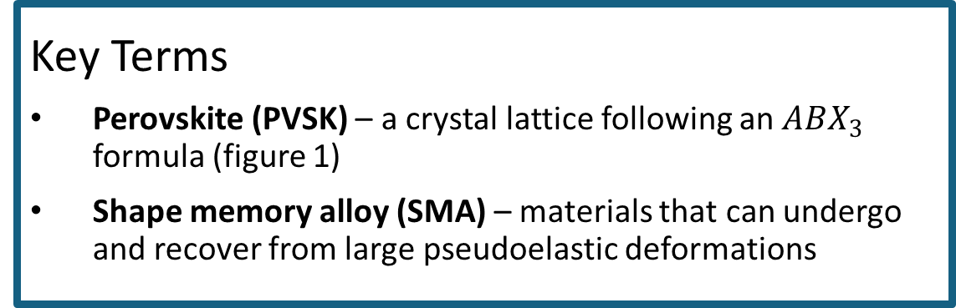

Background – Halide Perovskites
Key Terms
Perovskite (PVSK) – a crystal lattice following an $ABX_{3}$ formula (figure 1)
Shape memory alloy (SMA) – materials that can undergo and recover from large pseudoelastic deformations
Figure 1: $ABX_{3}$ perovskite crystal structure
Current Barriers
Production scaling
Instability
Fragility
Benefits
Low cost
Flexible
Lightweight
Radiation resistant
Figure 2: PVSK samples used for NASA’s MISSE mission

Slide 3
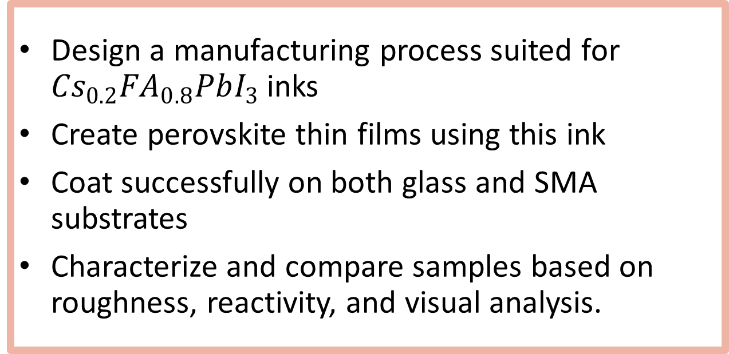
Objectives
Design a manufacturing process suited for ${Cs}_{0.2}{FA}_{0.8}PbI_{3}$ inks
Create perovskite thin films using this ink
Coat successfully on both glass and SMA substrates
Characterize and compare samples based on roughness, reactivity, and visual analysis.
Notes:
Talk about recipe suited for thermal stability

Slide 4
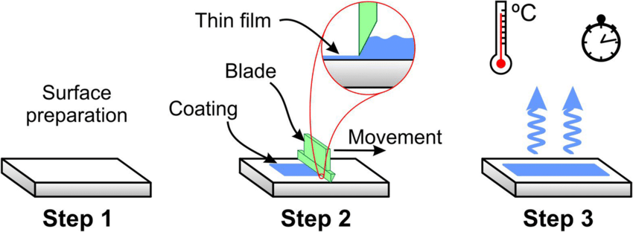
The ink is deposited as a thin film onto glass using blade coating
Gellan gum is added to the ink to achieve the higher viscosity
Samples are quenched with nitrogen gas during coating
Substrates are preheated at 50C and annealed at 150 C
Manufacturing Design
Figure 3: Illustration of the blade coating process.
Parameters
Gum concentration
Substrate type
Blade height
Blade speed
Ink volume
Gas quenching
Preheat temperature
Annealing temperature
Scalable
Low cost
Suitable for space-bound devices
Notes:
Highlight a few key parameters (note that the rest are important, for the sake of this we don’t need those details)

Slide 5
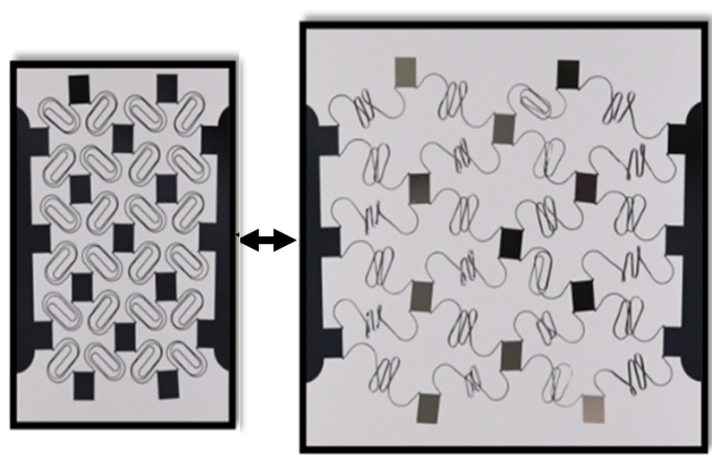
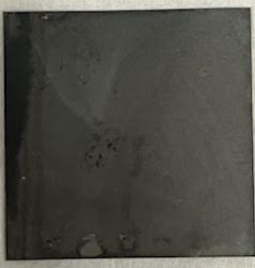
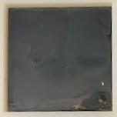
Selecting Substrates
Substrates Investigated
Glass – a rigid, nonconductive, relatively smooth substrate.
NiTi SMA – a flexible, stretchable, conductive alloy.
Figure 4: Images of glass (left) and SMA (right) PVSKs
Figure 5: Visual representation of stretchable electronics (Khanjur)
Property | Glass | Nickel-Titanium Shape Memory Alloy (SMA)
Maximum height difference (μm) | 0.32 | 5.2
Rigidity | Extremely rigid | Flexible, able to recover original shape after deformation
Conductivity | Low to none | Thermal and electrical
Benefits in PVSK Manufacturing | Smoother surface is easier for coating films Well established in PVSK research | Roughness beneficial to light absorption Wider range of applications due to flexibility Conductivity can be utilized for device integration Deformation recovery
Notes:
Half micron thin film on very thick substrate
Thermal AND conductive properties of SMA can help with resilience in space applications

Slide 6
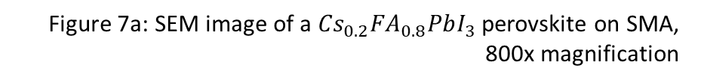
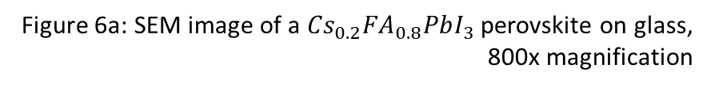
Characterization: Scanning Electron Microscopy (SEM)
Figure 6a: SEM image of a ${Cs}_{0.2}{FA}_{0.8}PbI_{3}$ perovskite on glass, 800x magnification
Figure 7a: SEM image of a ${Cs}_{0.2}{FA}_{0.8}PbI_{3}$ perovskite on SMA, 800x magnification
Notes:
Scanning electron microscopy (SEM) – a high-resolution imaging technique based on the use of a focused beam of electrons 5

Slide 7
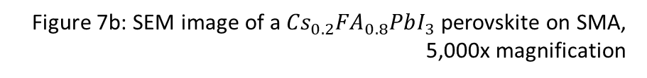
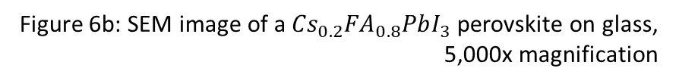
Characterization: Scanning Electron Microscopy (SEM)
Figure 6b: SEM image of a ${Cs}_{0.2}{FA}_{0.8}PbI_{3}$ perovskite on glass, 5,000x magnification
Figure 7b: SEM image of a ${Cs}_{0.2}{FA}_{0.8}PbI_{3}$ perovskite on SMA, 5,000x magnification

Slide 8
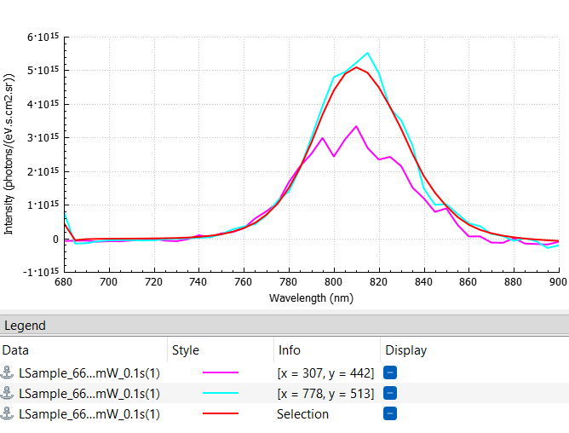
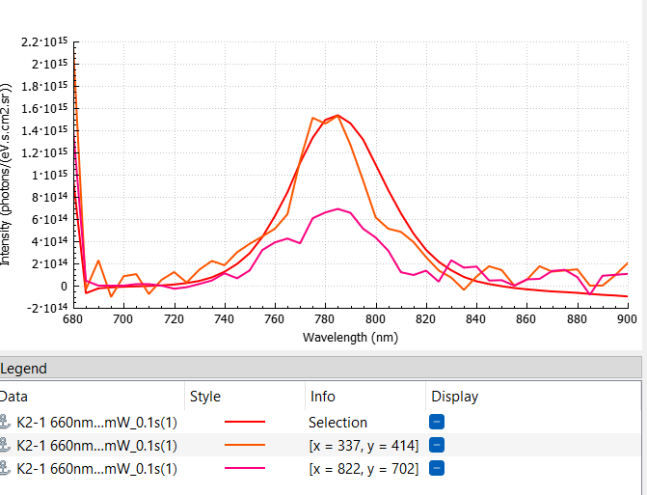

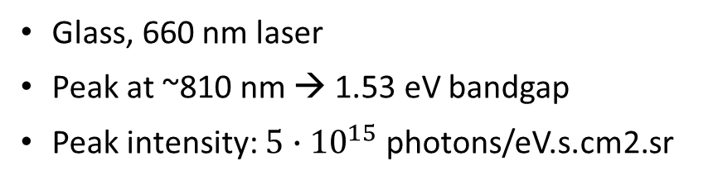
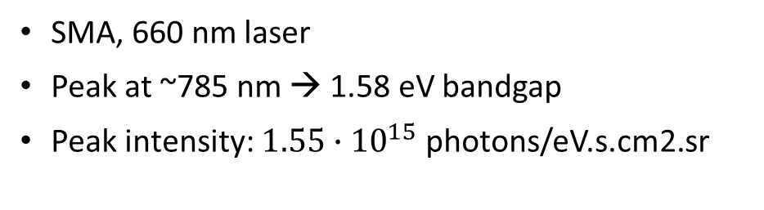

Characterization: Performance
Glass, 660 nm laser
Peak at ~810 nm → 1.53 eV bandgap
Peak intensity: $5∙{10}^{15}$ photons/eV.s.cm2.sr
SMA, 660 nm laser
Peak at ~785 nm → 1.58 eV bandgap
Peak intensity: $1.55∙{10}^{15}$ photons/eV.s.cm2.sr
Figure 9: Intensity vs. Wavelength graph generated with hyperspectral PL. Sample: ${Cs}_{0.2}{FA}_{0.8}PbI_{3}$ PVSK on glass
Figure 8: Intensity vs. Wavelength graph generated with hyperspectral PL. Sample: ${Cs}_{0.2}{FA}_{0.8}PbI_{3}$ PVSK on SMA
Notes:
Photon flux – (y axis) - Photons at a given energy level per time at a given volume (at a given wavelength, for some amount of time, integrated for volume)
Higher number means more powerful (in general) – glass may be a thicker film
Same order of magnitude is still promising for SMAs even if lower than glass (PVSK working effectively as a solar cell in both cases)
Photoluminescence spectroscopy (PL) – a characterization technique that measures response to light 4 look @ SURI 2024 hyperspectral poster

Slide 9
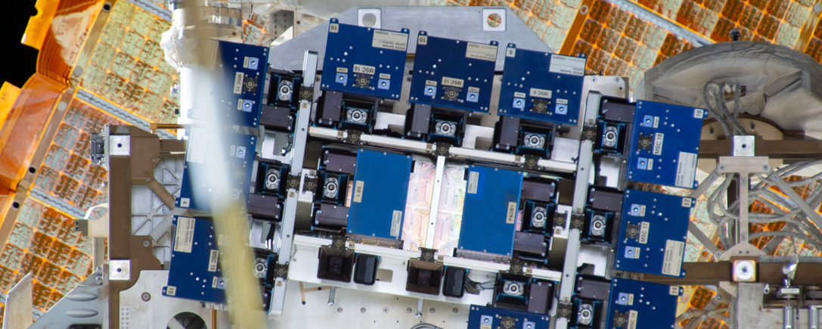
Conclusion and Further Research
PVSKs on both glass and SMA substrates show viability for use in photovoltaics
PL analysis shows functionality and response to light
SEM shows high quality PVSK phase conversion in SMA samples
Conduct stress testing to test stability against
Light
Heat
Radiation
Humidity (prior to launch)
Integrate into functional photovoltaic devices
Explore applications with stretchable electronics
Medical Applications
Space Exploration
Figure 10: Perovskites inside the MISSE platform on the International Space Station (NASA)

Slide 10
References
1. ACS Appl. Mater. Interfaces 2022, 14, 21, 24073–24088
2. Bausback, E. 10-Month Voyage Proves Solar Cell Material Survives, Thrives in Space. https://www.nasa.gov/general/10-month-voyage-proves-solar-cell-material-survives-thrives-in-space/ (accessed 2025-04-04).
3. Expertise. https://khanjur.com/services/ (accessed 2025-04-02).
4. Fabrication of β-Cyclodextrin-Assisted Tungsten Trioxide Nanosheets and Their Remarkable Adsorption, Photocatalytic Performance, and Biomedical Properties. Journal of Cluster Science. 10.1007/s10876-024-02647-4.
5. Perovskite Solar Cells. https://www.energy.gov/eere/solar/perovskite-solar-cells (accessed 2025-04-02).
6. Photoluminescence Spectroscopy. https://www.sciencedirect.com/topics/chemistry/photoluminescence-spectroscopy#:~:text=PL%20(Photoluminescence%20Spectroscopy)%20uses%20a,observe%20material%20imperfections%20and%20impurities (accessed 2025-04-02).
7. Scanning Electron Microscopy. https://www.nanoscience.com/techniques/scanning-electron-microscopy/ (accessed 2025-04-02).
8. Shape Memory Alloy. https://www.sciencedirect.com/topics/engineering/shape-memory-alloy (accessed 2025-04-02).
9. The Stability of inorganic perovskite solar cells: from Materials to Devices. Materials Futures. 2. 10.1088/2752-5724/acd56c.
10. Triolo, T. MacroTechnology Works Collaborations Spark Industry Innovation. https://news.asu.edu/20230316-macrotechnology-works-collaborations-spark-industry-innovation (accessed 2025-04-02).

Slide 11
Acknowledgements
Dr. Nick Rolston
Desiree Crawl & Dr. Thomas Sharp
Muneeza Ahmad
Khanjur R&D
Shatakshi Iksha, Kay Bakshi, & Sierra Monreal
Gwen, Mikkel, and Brynn Hylden
Audrey Alcorn, Kylie Stinson, Claire Westing, and the rest of my incredibly kind and supportive friends

Slide 12
Thank you!

Slide 13
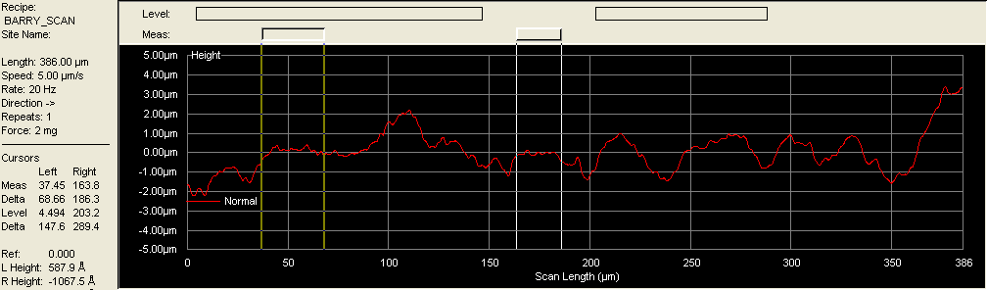
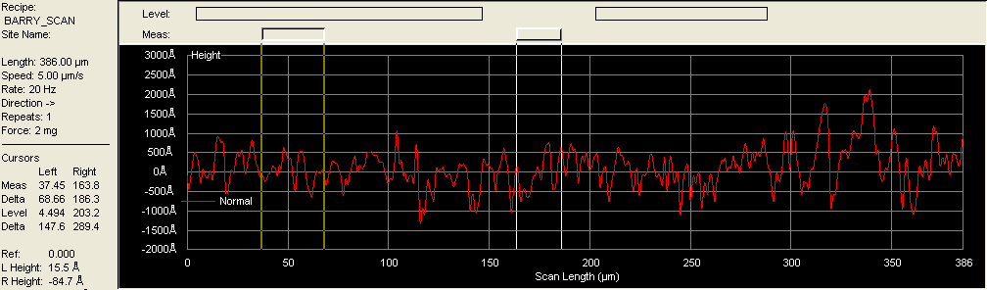
Characterization: Roughness
Figure 11: Roughness graph of a blade coated SMA perovskite
Graphs generated using profilometry, a roughness imaging technique, show a view of the height changes over a linear segment of each PVSK sample.
While SMAs have greater roughness, these height changes happen over a longer distance, making thin film formation still possible.
Figure 12: Roughness graph of a blade coated glass perovskite

Slide 14
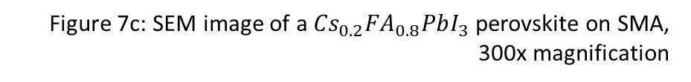
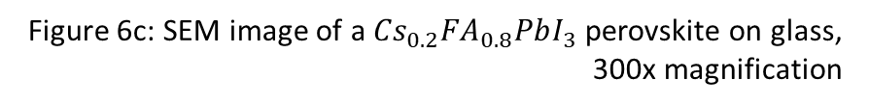
Characterization: Scanning Electron Microscopy (SEM)
Figure 6c: SEM image of a ${Cs}_{0.2}{FA}_{0.8}PbI_{3}$ perovskite on glass, 300x magnification
Figure 7c: SEM image of a ${Cs}_{0.2}{FA}_{0.8}PbI_{3}$ perovskite on SMA, 300x magnification

